Slide 1
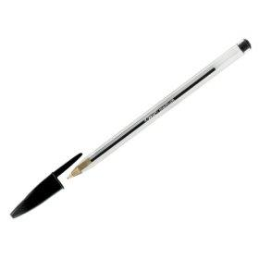
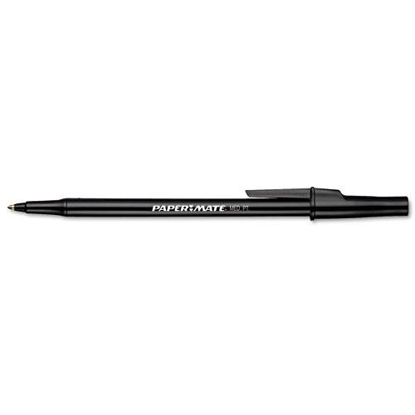
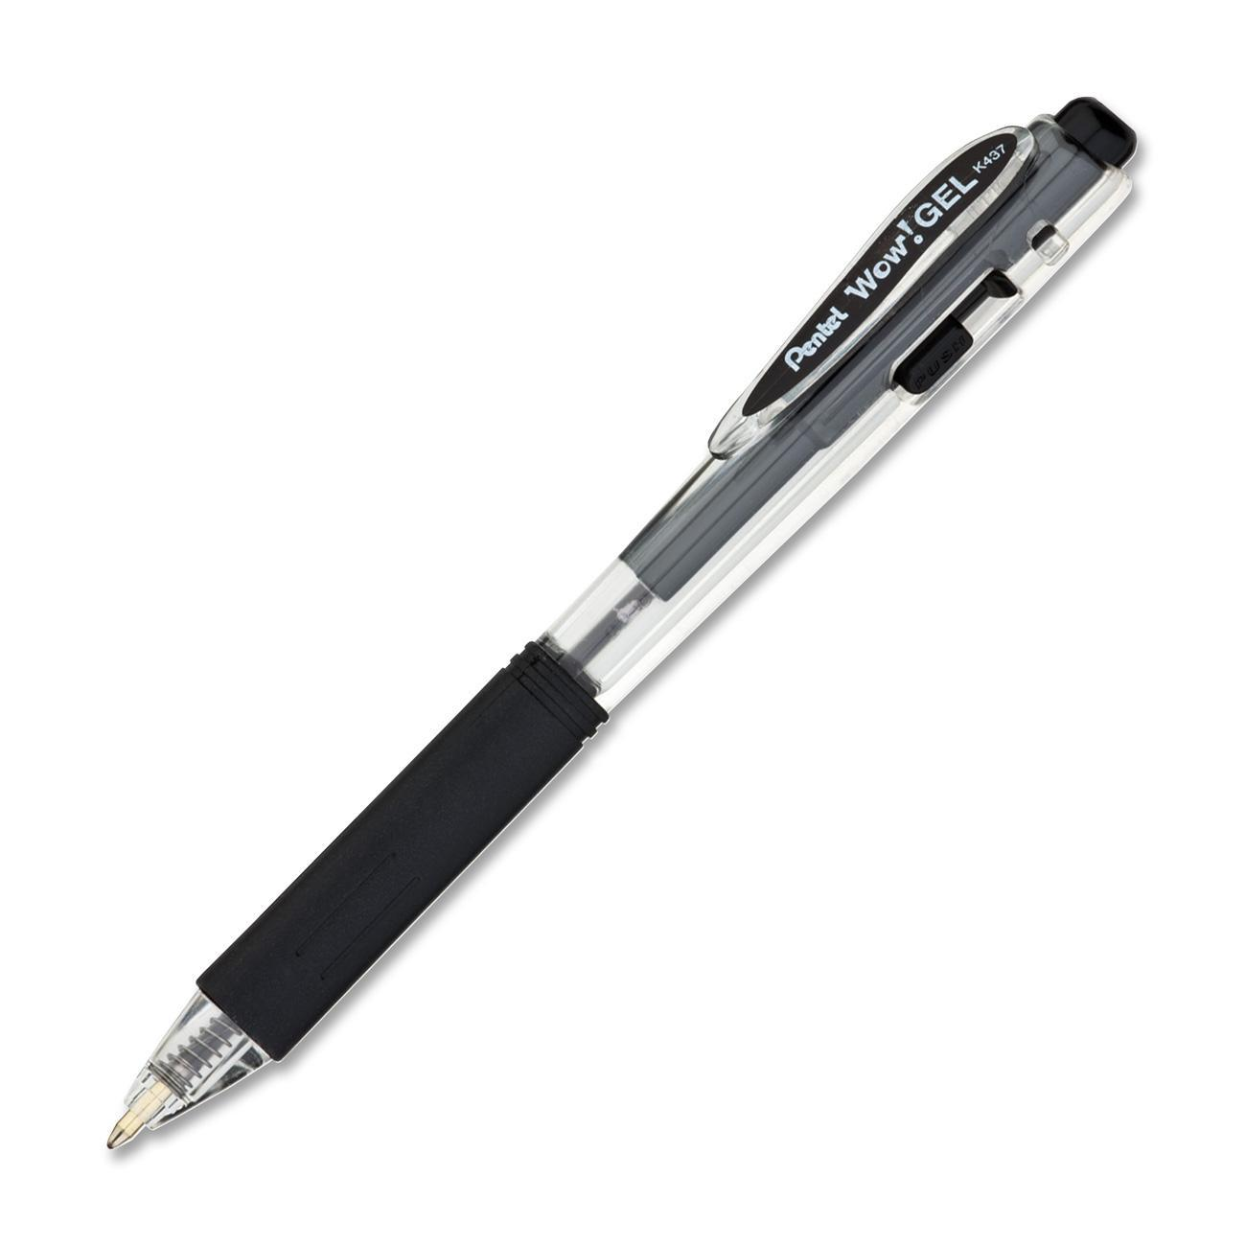
Picking the Perfect Pen
By Emily Yates, Kofi Wellington, Austin Young, and Jonathan Scott Weiss

Slide 2
Introduction
24 participants were asked to rank 3 pens that are available at Kroger® in packages of 5 or more.
Papermate®
BIC® Cristal®
Pentel® Wow™

Slide 3
Introduction Continued
We evaluated these pens from survey data we obtained using the following criteria:
Smoothness
Visual Appeal of Ink
Price per Pen
Comfort

Slide 4
Methods
We first had participants test each pen and rate each criterion from 1-3, 3 being excellent and 1 being sub par.
Figure 1: Survey Ranking Criteria for Each Pen

Slide 5
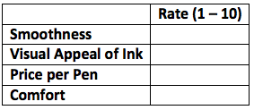
Methods Continued
We then asked the participants to rank each of the criterion from 1-10. 10 being most important and 1 being least important when they are buying pens.
Figure 2: Survey Ranking Criteria in Importance when Pen Shopping

Slide 6
Methods Continued
Smoothness, Visual Appeal of Ink, and Comfort were evaluated by the participants:
Smoothness: Pens were evaluated by how easily they wrote, 3 being very easily and 1 being poorly.
Visual Appeal of Ink: Pens were ranked by how the ink looked on paper, 3 being very dark and 1 being light.
Comfort: Pens were ranked by how they felt in the hand, 3 being very comfortable and 1 being uncomfortable.

Slide 7
Methods Continued
The points for Price per Pen were calculated by our team:
Ranked the pens from 1-3 (least to most expensive)
Multiplied each number by 24 (the number of participants)
Obtained unweighted points for each type of pen

Slide 8
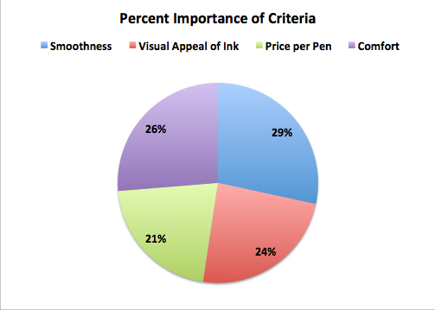
Methods Continued
We calculated weighted scores for each criterion by taking the criteria scores obtained from the participants and calculating the percent importance for each criterion. These results are displayed in Figure 3.
Figure 3: Percent of Importance for Each Criteria

Slide 9
Results
We multiplied the total points the pens received for each criterion by their percentage of importance to determine their weighted total points. The following slide with Figure 4 shows the results of our surveys and calculations.

Slide 10
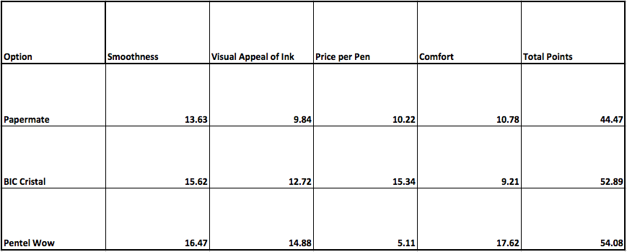
Results Continued
Figure 4: Chart for Ranking Criteria with Weighted Points

Slide 11
Conclusion & Recommendation
Conclusion
Because we used a weighted point system, we were able to calculate which criteria were more important to the participants and give a pen recommendation based on it. While the answer to which pen was preferred most seemed clear, the total points were very close between two of our options.
Recommendation
We recommend the Pentel Wow if Smoothness, Visual Appeal of Ink, and Comfort are the most important pen traits to you, but if Price per Pen is your primary concern the BIC Cristal is a close runner-up and costs a quarter of the price per pen.

Slide 12
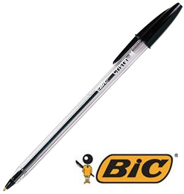
Recommendation Continued
BIC® Crystal®
$1.14/10 = $0.11 per pen
Overall Points - 52.89 points
Pentel® Wow™
$2.22/5 = $0.44 per pen
Overall Points - 54.08 points
While Pentel® Wow™ has the most points overall, it is 4 times more expensive per pen than the BIC® Cristal® and comes in a package with half the number of pens. BIC® Cristal® is a more cost-effective pen.

